Slide 1
Asexuality

Slide 2
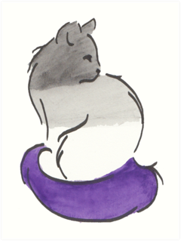
What is Asexuality?
The lack of sexual attraction, and/or a low or absent interest in or desire for partnered sexual activity.
Asexuality is not:
Low Libido
Celibacy
A lifestyle choice
An illness / unnatural
Necessarily caused by negative experiences / trauma
A phase
Based on experience
Based on practice
Aromaticism is the lack of romantic attraction and/or low desire to be in a romantic relationship
Notes:
Sexual attraction:
More of a mental thing
Sexual attraction can trigger libido
Helps target libido
Libido:
Sex drive
Can be activated by sexual attraction or unrelated
The libido is when your genitals say “Hey! Hey! Down here! Notice me! I wanna do something! Down here! Hey!” and generally nag you for attention.
Ace people often have a libido, but it’s not really targeted at anything.
Some ace people don’t have a libido.
Arousal:
Arousal is when your genitals physically react to something.

Slide 3
Demisexuality and Greysexuality
Demisexuality is when a person may experience sexual attraction but only after they have formed a strong emotional bond with someone.
Greysexuality is when someone only experiences sexual attraction rarely or in specific circumstances.
Grey/demisexual
Asexual
Allo/Zedsexual
Notes:
Umbrella terms
A demisexual is a person who may experience sexual attraction but only after forming a strong emotional connection with someone.

Slide 4
The Split Attraction Model
Not everyone’s sexual attraction aligns with their romantic orientation.
Someone who is asexual isn’t necessary aromantic, and vice versa.
People on the ace/aro spectrum may experience all or none of these types of attraction:
Sexual
Romantic
Sensual
Aesthetic
Platonic
They may choose to label their orientation in any of these categories e.g. Pan-aesthetic, aromantic, homo-sensual etc.
Anyone can use the split attraction model, whether or not they are on the ace or aro spectrums.
For some people, these types of attraction are tightly linked and indistinguishable from one another, for others they are entirely separate. It's totally up to each individual to label their attraction in whichever way they choose.
Notes:
A tool some use to explain asexual and aromantic experiences. Sometime you see the acronym SAM
Different categories of attraction:
Sexual
Desire to be in a sexual relationship
Want to do sexual things with another person
Romantic
Desire to be in a romantic relationship
Want to do romantic things with another person
Platonic
Desire to be in a platonic relationship
Desire to be close friends
Can be just as intense as romantic or sexual
Aesthetic
Admiring someone’s appearance
Not sexual, but can happen at the same time
Painting example
Sensual
Desire for sensual feedback from a person
Being attracted to the way a person smells or feels
Can often happen with another type of attraction or be confused with another attraction
Intellectual
Being attracted to a person’s brain and the way they think and process thoughts.
Alterous
Attraction that can only be described as a desire for emotional closeness
Neither romantic or platonic attraction is accurate
People don’t need to use the split attraction model if they don’t want to.
Everyone experiences attraction differently, and all experiences are valid.
There are also words for crushes corresponding to each type of attraction. I think they're quite cute, some people use them, some people don't.

Slide 5
Attitudes toward Sex
Sex averse / repulsed
Where an individual is averse to the idea of engaging in sexual activity, and may be squeamish about sex, whether involved or not.
Sex favourable
Where an individual is happy to engage in sexual activity, and may even enjoy it.
Sex neutral / indifferent
Where an individual has little or no feelings about sex or engaging in sexual activity.
Sex positive
Where an individual has a positive attitude towards sex and believes it can be empowering.
Sex negative
Where an individual has a negative attitude towards sex, typically viewing it as immoral.

Slide 6
Asexual Relationships
Ace people can be in a romantic relationship with anyone, regardless of their sexual orientation
Only thing that matters is that both are willing to communicate openly about boundaries
Every person has different boundaries around sex and romance.
Some ace or aro people may choose to be in a QPR. This stands for Queer/Quasi-Platonic Relationship and describes a relationship that is not strictly platonic or romantic.
Notes:
The important thing is to not assume anything, just have conversation about what each of you is comfortable with.

Slide 7
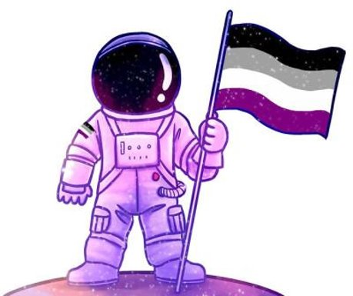
Things to Consider
Types of compromise in a romantic relationship:
Nonsexual intimacy
Open relationship or polyamory
Potential sex if both give enthusiastic consent
Enthusiastic consent is important-- you should never try to persuade someone to have sex
BDSM (can have sexual component or no)
Mutual masturbation
Other options, based on what both people are comfortable with

Slide 8
Nonsexual Intimacy (For Aces and Non-Aces)
Hug
Share things
Have deep conversations
Touch noses
Cuddle
Try to have a whole conversation with only eye contact and facial expressions
Learn something new together
Joke
Trace designs on their body
Listen to their heartbeat
Sing, do art, or play instruments together
Talk about and respect each others boundaries
Sit next to them
Be physically/emotionally vulnerable
Just sleep together
Take care of hygiene together
Nuzzle
Cry together
Compliment each other
Close your eyes and memorise each other’s faces with your fingers
Give massages
Tickle them
Play with their hair
Scratch their back
Be comfortable with each other’s bodily functions

Slide 9
Resources
Master list of many ace/aro resources: http://www.oulgbtq.org/acearo-resources.html
Aven - https://asexuality.org - forums for ace people and for friends, families and partners of aces.
Aropocalpse – https://aropocolypse.org - aro-spec forums
Demi/graysexuality panel from acecon 2020: https://youtu.be/8y8BhRrBpys
Demisexuality resource masterlist: https://www.reddit.com/r/demisexuality/comments/6peu8q/links_and_resources_masterpost/
Umbrella terms: https://lgbta.wikia.org/wiki/Asexual_Spectrum
Split attraction model: https://youtu.be/lZPnFcEkZNI
Ace/allo relationships from the allo side: https://youtu.be/FhRs4x9XWZI
Evie Lupine on YouTube is a good example of an ace person in BDSM: https://www.youtube.com/EvieLupine
QPRs: https://siobhancrosslin.wordpress.com/2017/08/05/on-queerplatonic-relationships-from-someone-whos-actually-in-one/
https://youtu.be/J6Xg9sA6XWA

